Slide 1
React Workshop

Slide 2


Team Members
Prasad Golla Durga
https://github.com/GD-Prasad
Soujanya Janapatla
http://github.com/jscodebit

Slide 3
Agenda
Introduction
Installation of react components
Modern Javascript
Rendering Elements
Components and Props
State and Lifecycle (super important!)
Handling Events
Forms
Demo App: Github Card

Slide 4
What is React ?
React is a JavaScript library created by Facebook.
React is a tool for building UI components.
How does React work?
React creates a VIRTUAL DOM in memory.
React only changes what needs to be changed.

Slide 5
Installation of react components
Install node and npm
- https://nodejs.org/en/ (Download link for node and npm)
$ npm init
$ npm install –save react
$ npm install –save react – dom
Babel and webpack - https://www.codementor.io/@seyiadeleke42/setting-up-a-react-development-environment-from-scratch-hbodiez1c
Code pen (for online eract editor)

Slide 6
Modern JavaScript: ECMAScript
ECMAScript is the language specification used to implement the JavaScript language. However, there are many new features in the latest versions of JavaScript that we'd like to use.
1. Variables and Block Scopes
2. Arrow Functions
3. Object Literals
4. Destructing and Rest/Spread
5. Template Strings
6. Classes or Class Components
7. Promises and Async/Await

Slide 7
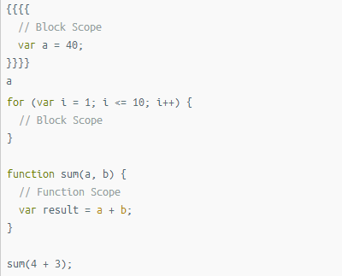
Variables and Block Scopes

Slide 8
Arrow Functions
Using inline arrow functions in function components is a good way to achieve some decoupling.
const squarel = (a) => {
return a*a;
}
const square2 = (a) => a*a;
const square2 = a => a*a;
[1,2,3,4].map(a => console.log(a*a));

Slide 9
Object Literals
We can create a JavaScript object in a few different ways, but the most common way is to use the object literal.
const mystery = 'answer';
const obj = {
p1 : 10, //default properties
p2: 20,
f1() {},
f2: () => {},
[mystery]: 42, // mystery is defined with dynamic property syntax
}

Slide 10
Destructing and Rest/Spread
const [first, ...restOfItems] = [10, 20, 30, 40];
console.log(first);
console.log(restOfItems);

Slide 11
Template Strings
We can define string literals is JavaScript in single quotes or double quotes. The modern JavaScript has third way of defining strings, which are template Strings
const html = `<div>
${Math.random()}
</div>`;
html;

Slide 12
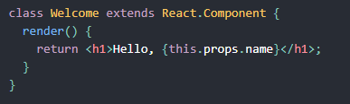
Classes or Class Components
Components let you split the UI into independent, reusable pieces, and think about each piece in isolation.
You can also use an ES6 class to define a component:

Slide 13
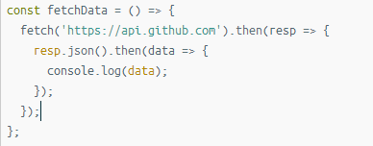
Promises and Async/Await
To work with asynchronous object we need to deal with promises objects, a promise is an object that might deliver the data at the later point in program.

Slide 14
JSX
JSX is an XML/HTML-like syntax used by React that extends ECMAScript so that XML/HTML-like text can co-exist with JavaScript/React code.
Babel is used to transform the java script file into the standard form JavaScript objects
JSX format
normal JavaScript format
var nav = (
<ul id="nav">
<li><a href="#">Home</a></li>
</ul>
);
var nav = React.createElement(
"ul",
{ id: "nav" },
React.createElement(
"li", null,
React.createElement(
"a", { href: "#" }, “Home”)));

Slide 15
Rendering Elements
Elements are the smallest building blocks of React apps.
An element describes what you want to see on the screen.
DOM elements, React elements are plain objects, and are cheap to create.
Applications built with just React usually have a single root DOM node.
<div id="root"></div>
To render a React element into a root DOM node, pass both to ReactDOM.render():
const element = <h1>Hello, world</h1>;
ReactDOM.render(element,
document.getElementById('root'));
React elements are immutable. Once you create an element, you can’t change its children or attributes.

Slide 16
Components and Props
Components let you split the UI into independent, reusable pieces.
And lets us deal about each piece in isolation.
components are like JavaScript functions. They accept arbitrary inputs (called “props”) and return React elements describing what should appear on the screen.
function Welcome (props){
return <h1>Hello, {props.name}</h1>;
}
Props are Read-Only
All React components must act like pure functions with respect to their props.

Slide 17
State and Lifecycle
Component has three states : Mounting, Updating, and Unmounting
Mounting
Constructor
Component will Mount
Render
Components Did Mount
Updating
Should Component Update
Component Did Update
Component Will Receive Props
Unmounting
Component Will Unmount

Slide 18
Event Handlers
Event Handling with react elements is similar to that of handling event on DOM elements.
React events uses camelCase to name.
A function is passed as a event handler.
<button onclick="activateLasers()">
Activate Lasers
</button>
HTML code
<button onClick={activateLasers}>
Activate Lasers
</button>
React code

Slide 19
Forms
HTML form elements work a little bit differently from other DOM elements in React, because form elements naturally keep some internal state. For example, this form in plain HTML accepts a single input value for “userName”:
This means that the form component can respond to input changes immediately; for example:
in-place feedback, like validation
disabling the button unless all fields have valid data
enforcing a specific input format

Slide 20
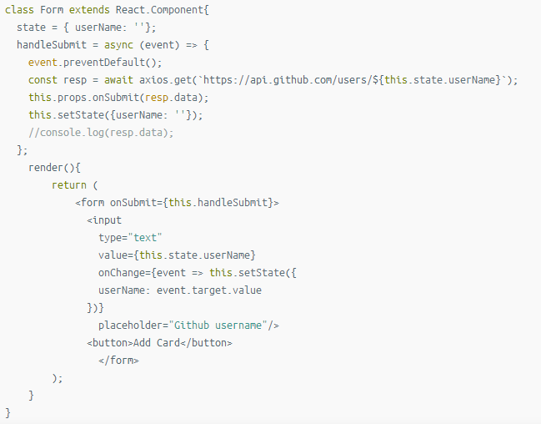
Forms

Slide 21
Demo App: Github Cards
Github URL:
https://github.com/jscodebit/react_project
Demo App Link:
https://jscomplete.com/playground/s459989

Slide 22
References
https://jscomplete.com/playground/s459989
https://medium.com/@vikasharry03/react-setup-on-local-computer-912f9a551af3
https://www.codementor.io/@seyiadeleke42/setting-up-a-react-development-environment-from-scratch-hbodiez1c
https://mdbootstrap.com/education/react/agenda-2-concept-review/
https://www.w3schools.com/react/react_intro.asp
https://reactjs.org/docs/state-and-lifecycle.html

Slide 23
Questions?
Please reach out to us incase if you have any questions. We will be glad to assist you with the details.

Slide 24
Thank You

